Slide 1
Graph-based Mining of In-the-Wild, Fine-grained, Semantic Code Change Patterns

Slide 2


Repetitiveness of Software
Repetitive Code
Parsing Java source file
Parsing Java source file
JDT
java.util
JDT
java.util
Tree traversal
Tree traversal
Smith
Nguyen

Slide 3
Repetitiveness of Software
Repetitive Change
Parsing Java source file
Parsing Java source file
JDT
java.util
JDT
java.util
Tree traversal
Tree traversal
Smith
Nguyen

Slide 4
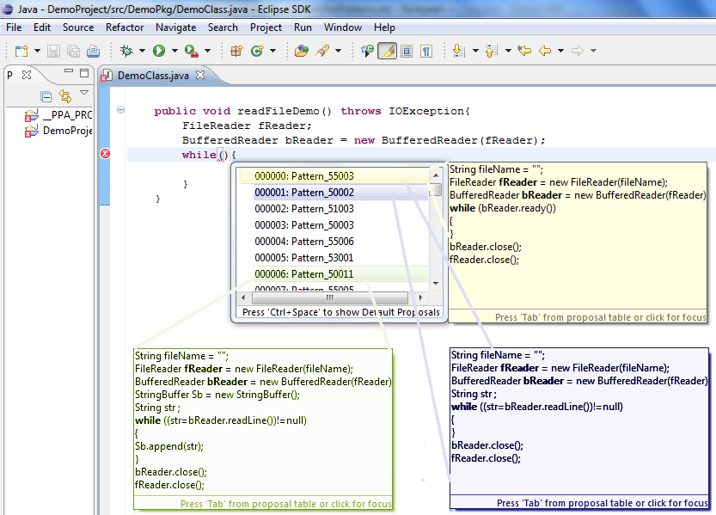
Change Pattern and Applications
Source code is repetitive
Code changes are repetitive
Applications of change pattern:
Change/fix recommendation
Code auto-completion

Slide 5


Change Pattern and Applications
Source code is repetitive
Code changes are repetitive
Applications of change pattern:
Change/fix recommendation
Code auto-completion
Programming patterns and code examples
Scanner.<init>
Scanner.hasNext
while
Scanner.next
Scanner.close

Slide 6
Change Pattern and Applications
Source code is repetitive
Code changes are repetitive
Applications of change pattern:
Change/fix recommendation
Code auto-completion
Programming patterns and code examples
Language migration
Refactoring support
...
-------
-------
--------
...
extract
method
...
-------
-------
--------
...
-------
-------
--------
...
-------
-------
--------
...

Slide 7
Example of Repeated Code Changes
Adapting a new language feature JDK1.4 → JDK1.5
Before
After
1– for (Iterator<Element> it = o.getElements().iterator(); it.hasNext();)
2– myElms.add (it.next());____________________________
1+ for (Element elm : o.getElements())________________
2+ myElms.add(elm);_______________________
Code refactoring
Before
After
1– List <HighlightInfo> list = new ArrayList <>();________________
2– for ( HighlightInfo info : highlights1 )_______________________
3– list.add (info);__________________________________
1+ List <HighlightInfo> result = new ArrayList <>();______
2+ result.addAll (highlights1);_______________________

Slide 8
Challenges of Semantic Change Pattern Detection
Syntactically un-changed program elements could carry the semantic context of change
Before
After
1
2
3 File f = new File ("Output.txt"); _______________________
4 FileOutputStream s = new FileOutputStream (f); _________
5 i = str.indexOf ("pattern",start); ______________________
1+ if (start <= 0) ____________________________________
2+ return; __________________________________
3 File of = new File ("Output.txt");______________________
4 FileOutputStream outStream = new FileOutputStream (of);
5 i = str.indexOf ("pattern",start);____

Slide 9
Challenges of Semantic Change Pattern Detection
Syntactically un-changed program elements could carry the semantic context of change
Elements of a semantic change could be non-contiguous in source code
Before
After
1
2
3 File f = new File ("Output.txt"); _______________________
4 FileOutputStream s = new FileOutputStream (f); _________
5 i = str.indexOf ("pattern",start); ______________________
1+ if (start <= 0) ____________________________________
2+ return; __________________________________
3 File of = new File ("Output.txt");______________________
4 FileOutputStream outStream = new FileOutputStream (of);
5 i = str.indexOf ("pattern",start);____

Slide 10
Challenges of Semantic Change Pattern Detection
Syntactically un-changed program elements could carry the semantic context of change
Elements of a semantic change could be non-contiguous in source code
Before
After
1
2
3 File f = new File ("Output.txt"); _______________________
4 FileOutputStream s = new FileOutputStream (f); _________
5 i = str.indexOf ("pattern",start); ______________________
1+ if (start <= 0) ____________________________________
2+ return; __________________________________
3 File of = new File ("Output.txt");______________________
4 FileOutputStream outStream =new FileOutputStream (of);
5 i = str.indexOf ("pattern",start);____

Slide 11
Challenges of Semantic Change Pattern Detection
Syntactically un-changed program elements could carry the semantic context of change
Elements of a semantic change could be non-contiguous in source code
Different semantic changes could have the same syntactic change representation
Before
After
1
2
...
5 i = str.indexOf ("pattern",start); ______________________
1+ if (start <= 0) _______________________________
2+ return; ______________________________
…
5 i = str.indexOf ("pattern",start);____
1 i = str.indexOf ("pattern", start);
2
3 3
4 sub = str .substring( i ) ; ______________________
1 i = str.indexOf ("pattern", start);
2+ if (start <= 0) _______________________________
3+ return; ______________________________
4 sub = str .substring( i ) ;

Slide 12
Challenges of Semantic Change Pattern Detection
Different semantic changes could have the same syntactic change representation
Before
After
1
2
…
5 i = str.indexOf ("pattern",start); ______________________
1+ if (start <= 0)________________________________
2+ return; ______________________________
…
5 i = str.indexOf ("pattern", start);____
1
2
3 3i = str.indexOf ("pattern", start); ______________________
1+ if (mode <= 0) ______________________________
2+ return; ______________________________
3 i = str.indexOf ("pattern", start);
Notes:
Un-related semantic changes could not be sufficiently distinguished by syntactic representation

Slide 13
Challenges of Semantic Change Pattern Detection
Syntactically un-changed program elements could carry the semantic context of change
Elements of a semantic change could be non-contiguous in source code
Different semantic changes could have the same syntactic change representation

Slide 14
Syntactically un-changed program elements could carry the semantic context of change

Slide 15
Elements of a semantic change could be non-contiguous in source code

Slide 16
Different semantic changes could have the same syntactic change representation
Un-related semantic changes could not be sufficiently distinguished by syntactic representation

Slide 17
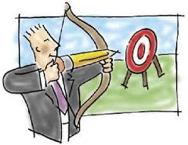
CPatMiner
Uses program dependence graph to capture dependencies between program elements involved in atomic changes, and
Infers semantic change patterns using frequent sub-graph mining

Slide 18
Fine-grained Code Representation
getElements()
recv
iterator()
def
Operation
Iterator
Data
recv
for (Iterator<Element> it = o.getElements().iterator(); it.hasNext();)
myElms.add (it.next);
hasNext()
Control
cond
edge type
For
control
control
next()
recv
para
add()
Notes:
Considering to use the same example as in the observations
Why…

Slide 19
Fine-grained Code Representation
getElements()
recv
iterator()
def
Operation
Iterator
Data
recv
for (Iterator<Element> it = o.getElements().iterator(); it.hasNext();)
myElms.add (it.next());
hasNext()
Control
cond
edge type
For
control
control
next()
recv
para
add()

Slide 20
Fine-grained Code Representation
getElements()
recv
iterator()
def
Operation
Iterator
Data
recv
for (Iterator<Element> it = o.getElements().iterator(); it.hasNext();)
myElms.add (it.next);
hasNext()
Control
cond
edge type
For
control
control
next()
recv
para
add()
Notes:
Considering to use the same example as in the observations
Why…

Slide 21
Fine-grained Code Representation
getElements()
recv
iterator()
def
Operation
Iterator
Data
recv
for (Iterator<Element> it = o.getElements().iterator(); it.hasNext();)
myElms.add (it.next);
hasNext()
Control
cond
edge type
For
control
control
next()
recv
para
add()
Notes:
Considering to use the same example as in the observations
Why…

Slide 22
Fine-grained Code Representation
getElements()
recv
iterator()
def
Operation
Iterator
Data
recv
for (Iterator<Element> it = o.getElements().iterator(); it.hasNext();)
myElms.add (it.next);
hasNext()
Control
cond
edge type
For
control
control
next()
recv
para
add()

Slide 23
Fine-grained Code Representation
for (Iterator<Element> it = o.getElements().iterator(); it.hasNext();)
myElms.add (it.next);
for (Element elm : o.getElements())__ myElms.add(elm);_______________________
getElements()
getElements()
recv
iterator()
def
def
Iterator
Element
cond
recv
cond
hasNext()
cond
para
Enhanced For
para
For
control
control
next()
para
control
recv
add()
add()

Slide 24
Fine-grained Change Representation
Before
After
1– for (Iterator<Element> it = o.getElements().iterator(); it.hasNext();)
2– myElms.add (it.next());___________________________
1+ for (Element elm : o.getElements())______
2+ myElms.add(elm);_____________
getElements()
getElements()
recv
un-changed map
iterator()
def
def
Iterator
Element
cond
recv
cond
hasNext()
cond
para
Enhanced For
para
For
control
control
next()
para
control
recv
un-changed map
add()
add()

Slide 25
Fine-grained Change Representation
Before
After
1– for (Iterator<Element> it = o.getElements().iterator(); it.hasNext();)
2– myElms.add (it.next());___________________________
1+ for (Element elm : o.getElements())______
2+ myElms.add(elm);_____________
getElements()
getElements()
recv
un-changed map
iterator()
def
def
Iterator
Element
cond
recv
Deleted
cond
hasNext()
cond
Added
para
Enhanced For
para
For
control
control
next()
para
control
recv
un-changed map
add()
add()

Slide 26
Fine-grained Change Graph Pattern Mining
A
A’
A
A’
Mining frequent subgraphs
B
C
B
C
Source code
changes
Extracting change graphs
A
A’
B
C
A
A’
A
A’
Pattern
B
C
B
C

Slide 27
Mining Approach Components
Generating frequent subgraphs
Comparing (sub)graphs
Challenges
There are exponentially many subgraphs
Graph isomorphism is computationally expensive

Slide 28
Solutions
Solutions
Using vector-based signature instead of graph isomorphism [Nguyen et al. FASE’09]
Mining patterns from small to large, generate candidates of large size from patterns of small size
Extending subgraphs greedily to avoid combinatorial explosion

Slide 29
Comparing Graphs
A
B
B
C
C
A
A
A
B
B

Slide 30

Comparing Graphs
A
B
B
C
C
A
A
A
B
B
Feature | A | B | C | A→A | A→B | A→C | B→A | C→B
Count | 2 | 2 | 1 | 1 | 2 | 1 | 1 | 1
Feature | A | B | C | A→A | A→B | A→C | B→A | C→B
Count | 2 | 2 | 1 | 1 | 2 | 1 | 1 | 1
Comparing Graphs ≈ Comparing Vectors
[Nguyen et al. – Fundamental Approaches to Software Engineering 2009]

Slide 31
Comparing Graphs
A
B
C
A
B
Feature | A | B | C
Count | 2 | 2 | 1

Slide 32
Comparing Graphs
A
B
C
A
B
Feature | A | B | C | A→A | A→B | A→C | B→A | C→B
Count | 2 | 2 | 1 | 1 | 2 | 1 | 1 | 1
2-path

Slide 33
Comparing Graphs
A
B
C
A
B
Feature | A | B | C | A→A | A→B | A→C | B→A | C→B | ABA | AAB | ACB | BAB
Count | 2 | 2 | 1 | 1 | 2 | 1 | 1 | 1 | 1 | 1 | 1 | 1
3-path

Slide 34
Generating Frequent Subgraphs
Larger frequent subgraphs contain smaller frequent subgraphs

Slide 35
Generating Frequent Subgraphs
A
A
B
A
A
A
C
B
B
B
B
A
C
C
B
C
C
Graph
1
Graph
2
Graph 3
Graph 4
35

Slide 36
Starting with pattern of size 1
A
A
B
A
A
A
A
C
B
B
B
B
B
A
C
C
C
B
C
C
Pattern
of size 1
Graph
1
Graph
2
Graph 3
Graph 4
36

Slide 37
Extending occurrences of size 1 to candidates of size 2
A
A
B
A
A
A
A
C
B
B
B
B
B
A
C
C
C
B
C
C
Pattern
of size 2
Graph
1
Graph
2
Graph 3
Graph 4
37

Slide 38
Extending occurrences of size 2 to candidates of size 3
A
A
B
A
A
A
A
C
B
B
B
B
B
A
C
C
C
B
C
C
Pattern
of size 3
Graph
1
Graph
2
Graph 3
Graph 4
non-overlapped
overlapped
38

Slide 39
Generating Frequent Subgraphs
Extending subgraphs greedily to avoid combinatorial explosion

Slide 40



Empirical Evaluation
1
Meaningful Patterns
2
Comparison with syntax-based approach
3
Activities
4
Commonality of Patterns
5
Temporal Distribution

Slide 41
Data Collection
 | Survey Corpus | Depth Corpus
Projects | 5,832 | 88
Total source files | 35M | 1M
Total SLOCs at last snapshots | 4.1B | 164M
Developers with analyzed commits | 171K | 13K
Java code change commits | 292K | 88K
Total changed files | 592K | 291K
Total SLOCs of changed files | 216M | 81M
Total changed methods (graphs) | 824K | 322K
Total AST nodes of changed methods | 92M | 34M
Total changed graph nodes | 8M | 3M

Slide 42
Meaningful Patterns (RQ1)
Surveying Real Developers
Q1: Is the change at these lines similar to another change in the past?
Q2: Can you briefly describe the change and why you made it?
Q3: Can you give a name for the change?
Q4: Would you like to have this change automated by a tool?
Dataset of 5,832 long-history, fresh and highly rated projects

Slide 43
Survey Results
Q1 Is the highlighted change at these lines similar to another in the past?
Yes | No | Not sure |  | No answer
69% | 22% | 6% |  | 3%
Q3 Can you give it a name?
Yes | No |  |  | No answer
79% | 18% |  |  | 3%
Q4 Would you like to have this change automated by a tool?
Yes | No | Not sure | Already Automated | No answer
44% | 34% | 9% | 10% | 3%

Slide 44
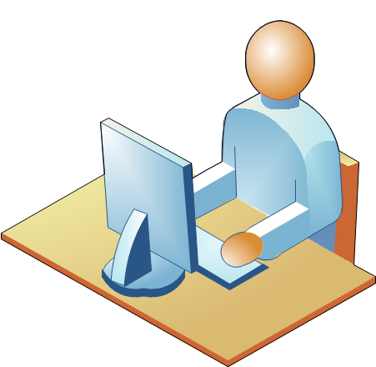
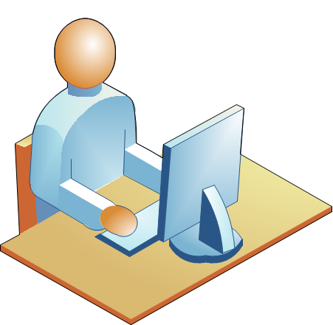
Examples for Q4
No, the tool would need to be able to make decisions based on the end use of the API which I would assume is not possible... (I might be wrong :))
I think it is very challenging which makes your research promising!
D15
D108

Slide 45
Examples
“I would definitely love a tool that checks my code
and propose me advanced refactoring”
Before
After
1 String id = Jobjet_event.getString("id");
2 if ( ! this . eventDao.isExisting(id) ) {_________
3
4 ….
5
6 this . eventDao.add(event); _____________
7 }
1 String id = Jobjet_event.getString("id”);
2 if ( this . eventDao.isExisting(id) ) {__________
3+ this . eventDao.add(event); ________
4+ } else {________________________________
5 ….
6 this . eventDao.add(event); _____________
7 }
“Adding a Condition Branch” Change Pattern in Project ApplETS
Notes:
https://nguyenhoan.github.io/CPatMiner for more examples

Slide 46
Diversity of Change Patterns (RQ3)
10% participants stated that the detected change patterns
have already been automated by IDEs

Slide 47
Comparative Study (RQ2)
Compare with the approach (BASE) using the syntax-based representation of changes
Run BASE on the same survey corpus
Randomly select pairs of changes
Human judgement

Slide 48
Comparative Results
CPatMiner detects 2.1x more
meaningful patterns than BASE
 | CPatMiner | BASE | Draw | Undecided
#Cases | 50 | 3 | 30 | 17
Percentage | 50% | 3% | 30% | 17%
Notes:
65% of the cases that BASE incorrectly detected as patterns
59% of the cases, BASE groups the atomic syntactic changes that have no relation

Slide 49
Comparative Results
 | CPatMiner | BASE | Draw | Undecided
#Cases | 50
Percentage

Slide 50
Example
Before
After
1 boolean isIdentifierIfAlreadyExisting (...) throws SQLException {
2
3 …
7 ResultSet rs = statement.executeQuery();
8 …
12 – statement.close() ; _________________________________
1 boolean isIdentifierIfAlreadyExisting (...) throws SQLException {
2
3+ try { ___________________________________________
7 ResultSet rs = statement.executeQuery(); ________
12+ } finally { closeQuietly (statement); } __________________
“Closing resources” Change Pattern in Project anHALytics
Notes:
BASE cannot relate the addition of closeQuietly(statement) on line 12 with the statement statement.executeQuery() on line 7
to form a meaningful pattern of closing resources used with executeQuery().

Slide 51
Commonality and Temporal Distribution
 | Depth Corpus
Projects | 88
Total source files | 1M
Total SLOCs at last snapshots | 164M
Developers with analyzed commits | 13K
Java code change commits | 88K
Total changed files | 291K
Total SLOCs of changed files | 81M
Total changed methods (graphs) | 322K
Total AST nodes of changed methods | 34M
Total changed graph nodes | 3M
Notes:
We aimed to study commonality and temporal distribution of change patterns.
We posit that the change patterns performed on different projects and by different programmers have different degrees of commonality and temporal distribution.

Slide 52
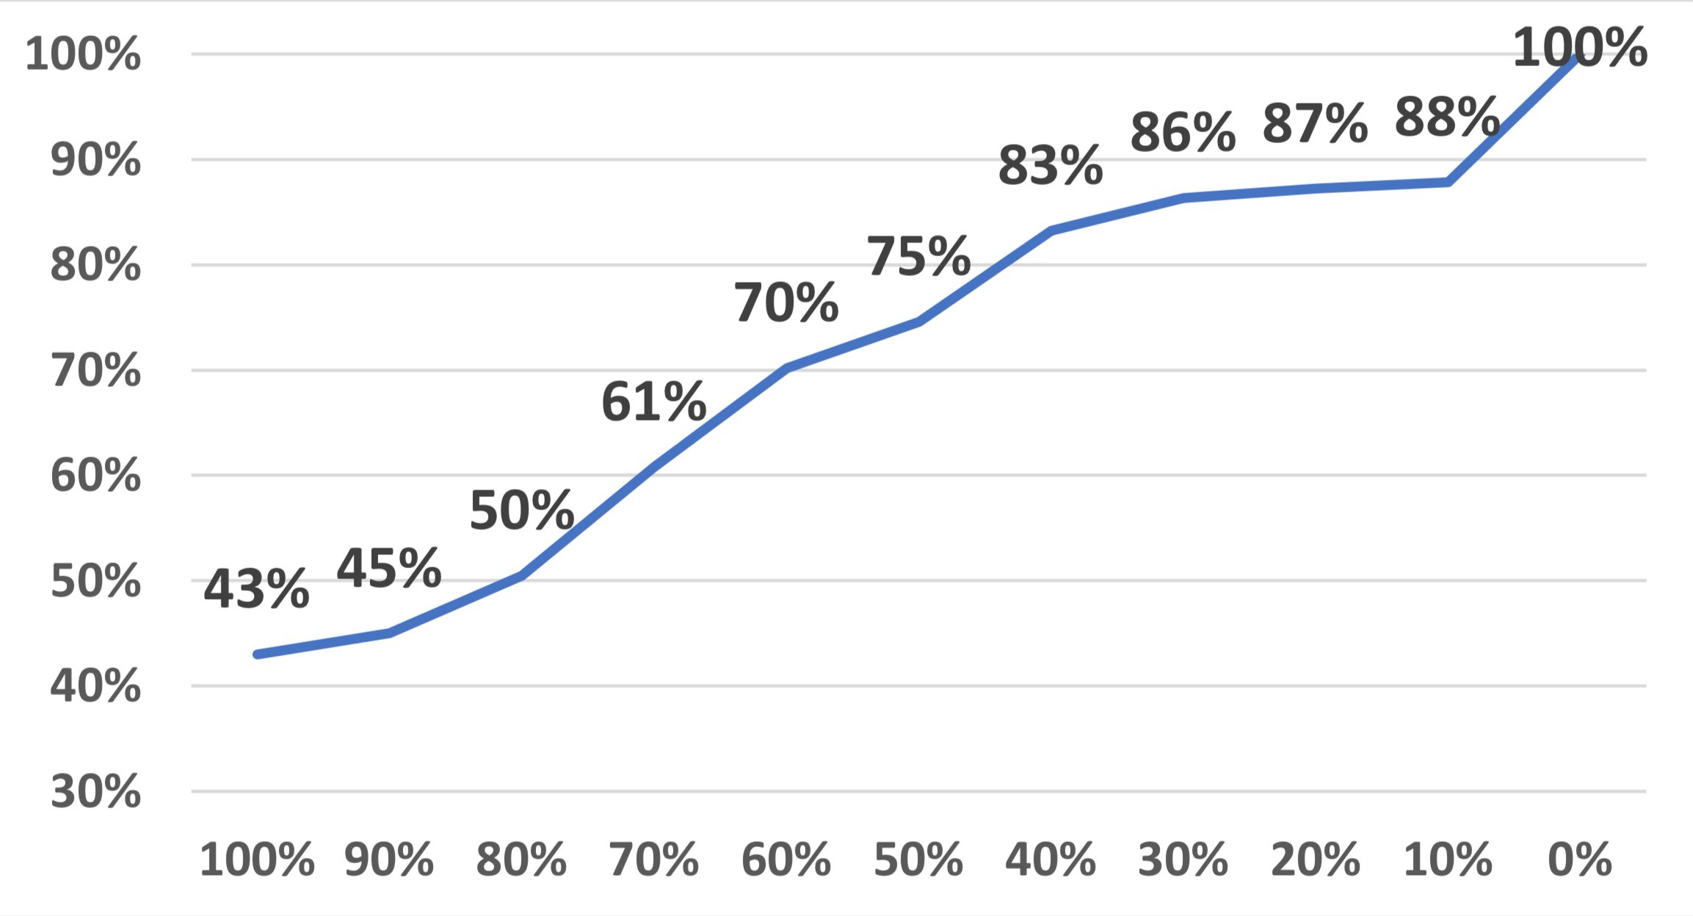
Commonality of Patterns (RQ4)
Over developers

Slide 53
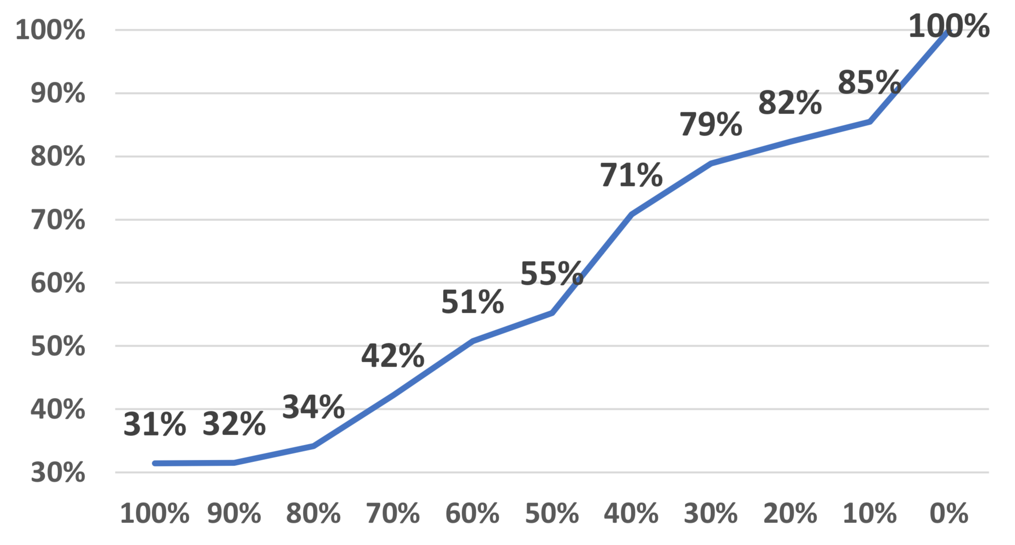
Commonality of Patterns (RQ4)
Fine-grained change patterns are pervasive
among developers and teams
Over developers
Over projects
Notes:
Same trend

Slide 54
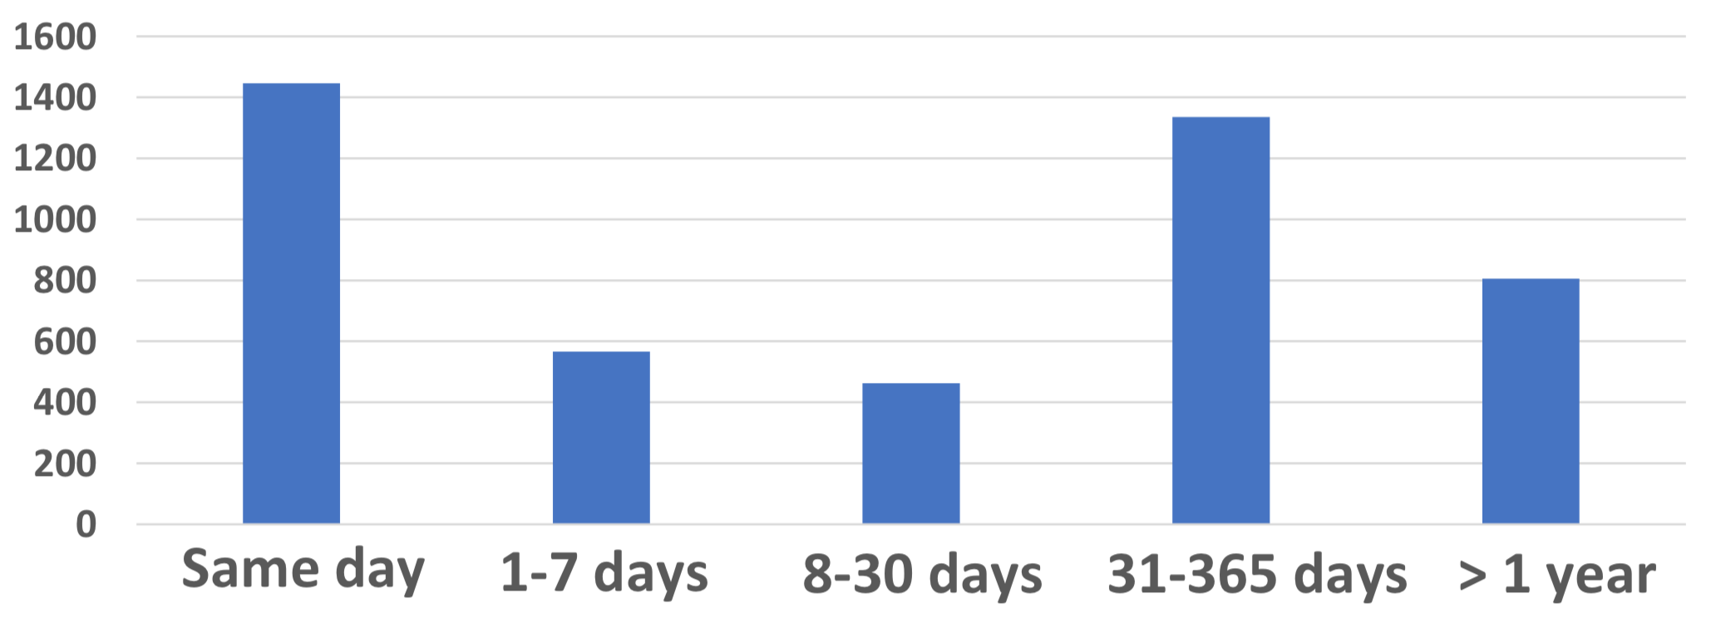
Temporal Distribution of Patterns (RQ5)

